Slide 1

Data Mining
Project Presentation
By: Sanee Salim

Slide 2
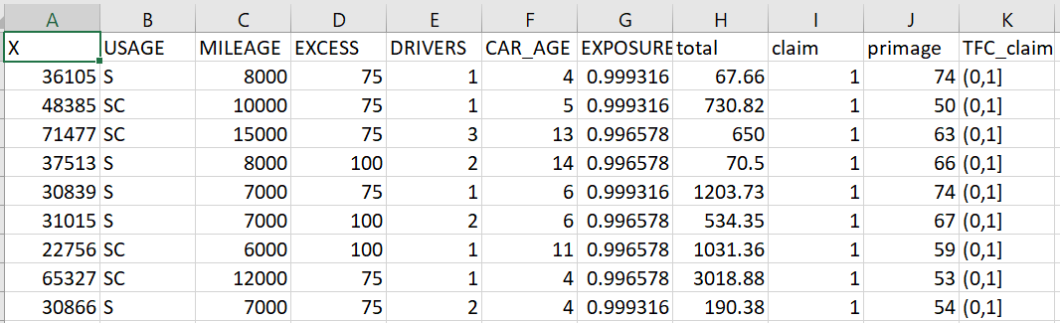
What was the Objective & Background?
Project Objective: Find the best classification model
Background of Dataset: Insurance companies trying to manage claims
How much Data did I have? 73506
What did my data look like?

Slide 3
How was the Analysis Conducted?
Data Processing
Descriptive Statistic
Exploratory Data Analysis
Classification Models
Simple Tree Model
Forest Model
Boost Model
SVM Model
Linear Model
Neural Network
Taking a sample of 10000 rows
5000 true 5000 false
Seeding according to Student ID
50% of the claims are more than 395 dollars
Average amount of claim is 611.3
No strong correlations between input variables
Younger and older drivers are more likely to have claims
People who tend to have higher excess have lesser fines

Slide 4
Findings
Most important variables were car age, primary driver’s age and car’s exposure according to random forest
Most important variables were usage, number of drivers, primary driver’s age according to Boost Ensemble
Increasing primary age and car age increases the odds of a claim while other variables need to be decreased to increase odds of claim according to Linear Model
Optimum number of hidden nodes for neural network in this dataset would be 3

Slide 5
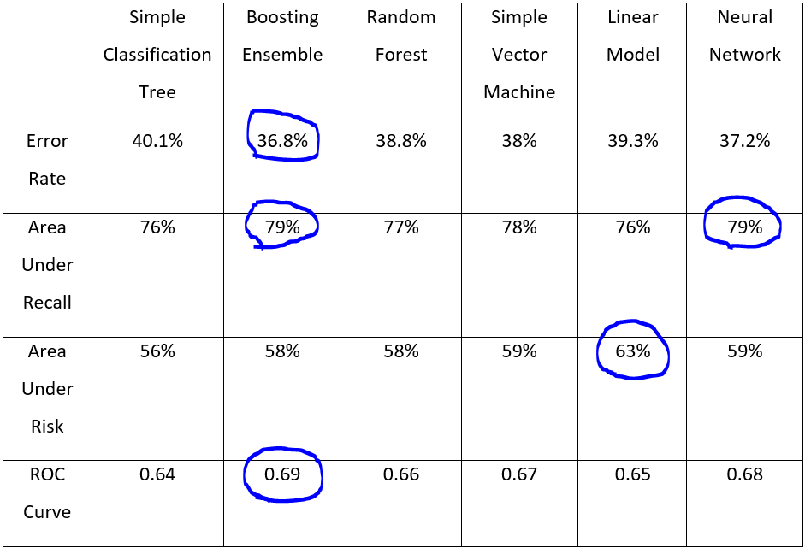
Why was Boosting Ensemble the best model?
Boosting Ensemble

Slide 6
So what is Boosting Ensemble?
What is a stump?
Bottom of a tree.
Only two branches no subbranches.
Weak Learners
Combines bunch of Stumps
Some Stumps get more say then others
Learns from previous errors
HOW??

Slide 7
How does ADA BOOST Work?
We create stumps for each variable
Calculate Gini index for each stump
The lowest Gini index becomes first stump
The amount of say this stump will get will be calculated
Sample weight of the incorrect row is changed
Then a new table is formed by choosing a random number between 0 and 1
This continues until all the rows of table are same.

Slide 8

Thank you

